Slide 1

Stack Overflow Developer Survey Data Analysis
Shirish Senthil Kumar
05/01/2023

Slide 2

Outline
Executive Summary
Introduction
Methodology
Results
Conclusion
This Photo by Unknown author is licensed under CC BY-SA.

Slide 3

Executive Summary
The necessary abilities for IT and business consulting are always changing and evolving.
To keep up with evolving technology and to stay competitive, it's critical to understand future skill requirements and trends.
This presentation will show current and future trends in Programming Languages, Databases, Platforms and Webframes.
The presentation will also aid in recognizing key skill shortages and the analysis will present data that can be used to make more informed data-driven budgetary decisions. IN
This Photo by Unknown author is licensed under CC BY-SA.

Slide 4
Introduction
Objective: To conduct a comprehensive analysis for stakeholders and business decision makers within the global IT and business consulting services firm based on StackOverflows Survey Data.
Desirable Outcomes:
Show strong correlation in key skill requirements data using SQL and Python.
Dashboard analytics to show key charts and maps.
This Photo by Unknown author is licensed under CC BY-SA.

Slide 5

Methodology
This Photo by Unknown author is licensed under CC BY-NC.

Slide 6
Data Collection - API
The data collection is carried through an API that connects to the survey data.
URL: http://127.0.0.1:5000/data
Payload Key-Value parameterization is used to access the key data.
Several functions is called to verify the results.
Source Code:https://github.com/Shirish026/IBM-Data-Analytics-Capstone-Project
Request API using URL
Python Functions to find no of jobs, location of jobs.
Saving the appended data as an Excel Workbook file.
This Photo by Unknown author is licensed under CC BY-SA.

Slide 7
Web Scrapping
Web Scrapping is carried through BeautifulSoup liibrary on the following URL
URL: https://cf-courses-data.s3.us.cloud-object-storage.appdomain.cloud/IBM-DA0321EN-SkillsNetwork/labs/datasets/Programming_Languages.html
Using the BeautifulSoup Object, data extraction is conducted.
Source Code:https://github.com/Shirish026/IBM-Data-Analytics-Capstone-Project
Request URL to launch data from IBM Cloud
BeautifulSoup object is created, and data is extracted
Dataframe is used to create columns Language and Avg Annual Salary
This Photo by Unknown author is licensed under CC BY-SA.

Slide 8
Data Wrangling
Data wrangling is the process of removing errors and combining complex data sets to make them more accessible and easier to analyze.
A function to calculate the annual compensation.
Source Code:https://github.com/Shirish026/IBM-Data-Analytics-Capstone-Project/blob/main/M2DataWrangling-lab.ipynb
Finding duplicates rows
Removing duplicate rows
Finding Missing values
Imputing missing values
Normalizing data
This Photo by Unknown author is licensed under CC BY-SA.

Slide 9
Exploratory Data Analysis
Exploratory Data Analysis refers to the critical process of performing initial investigations on data to discover patterns and trends.
Seaborn and Matplotlib to plot the graphs and charts to better understand the data.
Source Code: https://github.com/Shirish026/IBM-Data-Analytics-Capstone-Project/blob/main/M3ExploratoryDataAnalysis-lab.ipynb
Distribution plot using seaborn.
Histogram plot with bins using seaborn.
Determine Outliers by plotting boxplots.
Define the Correlation with Age.
This Photo by Unknown author is licensed under CC BY-SA.

Slide 10
Data Visualization
Using Seaborn and Matplotlib to plot the graphs to better understand the data.
Graphs plotted include Box, Histogram, Scatter plots, Bubble Plot, Pie Charts, Stacked Chart, Line Chart, Bar Chart.
Source Code:https://github.com/Shirish026/IBM-Data-Analytics-Capstone-Project/blob/main/M4DataVisualization-lab.ipynb
Extract required columns using Query in SQL.
Use Dataframe, seaborn and matlibplot to plot the charts.
Determine Outliers by plotting the charts.
This Photo by Unknown author is licensed under CC BY-SA.

Slide 11
Dashboard on Cognos Analytics
.CSV files of survey data are uploaded to IBM Watson and analyzed.
Three separate dashboards were set up, primarily: current trend, desired future trends and the demographic associated with these key IT skill roles.
Numerous Interactive Charts are plotted that can be filtered, sorted on the go.
Source Code:https://github.com/Shirish026/IBM-Data-Analytics-Capstone-Project
.CSV files are uploaded to IBM Watson Cloud.
The interactive charts help portray data in a digestible and easy to look at manner.
Cognos Analytics is launched, and the data is used to plot charts.
This Photo by Unknown author is licensed under CC BY-SA.

Slide 12
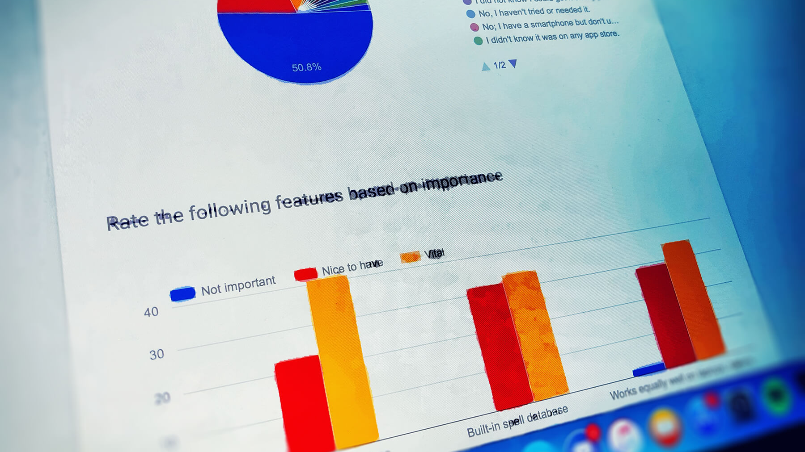
Results
This Photo by Unknown author is licensed under CC BY.

Slide 13
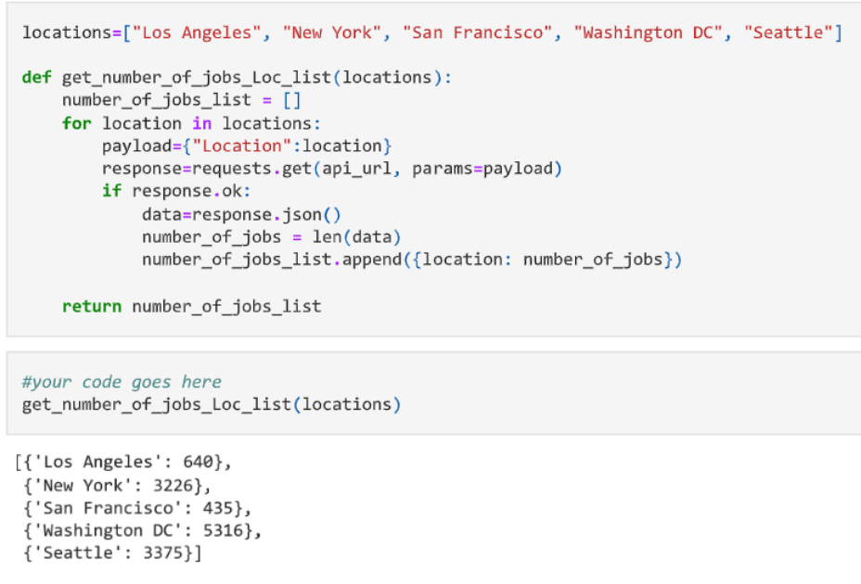
Data Collection using API
Screenshot shows the use of API URL to extract data with the use of function "get_number_of_jobs_Loc_list and payload parameters.
This Photo by Unknown author is licensed under CC BY-SA.

Slide 14
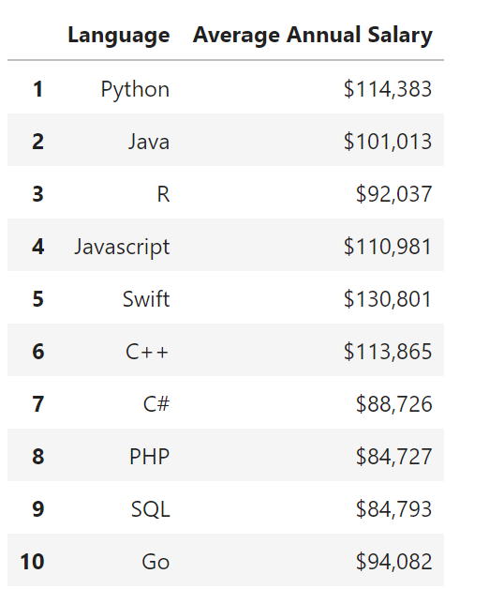
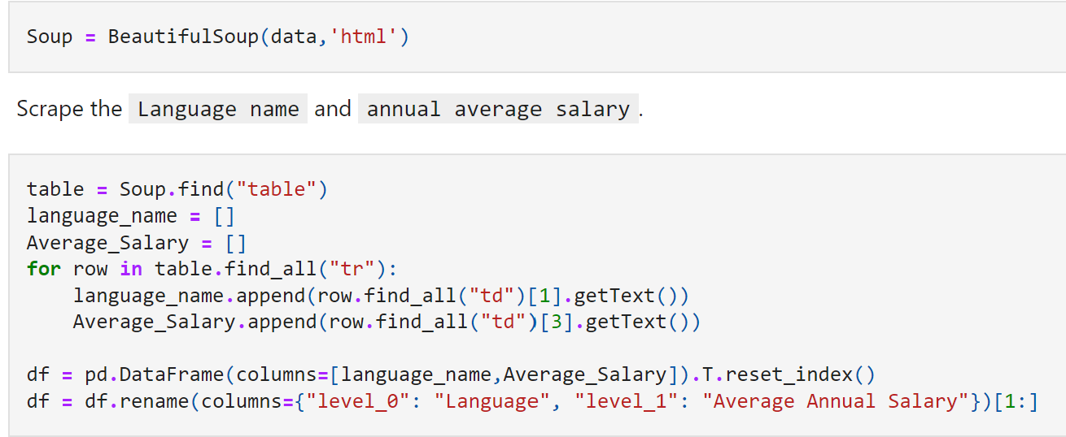
Web Scrapping
Screenshot shows the use of BeautifulSoup to extract data from the html link to create two rows of "Languages" and "Average Annual Salary".
This Photo by Unknown author is licensed under CC BY-SA.

Slide 15
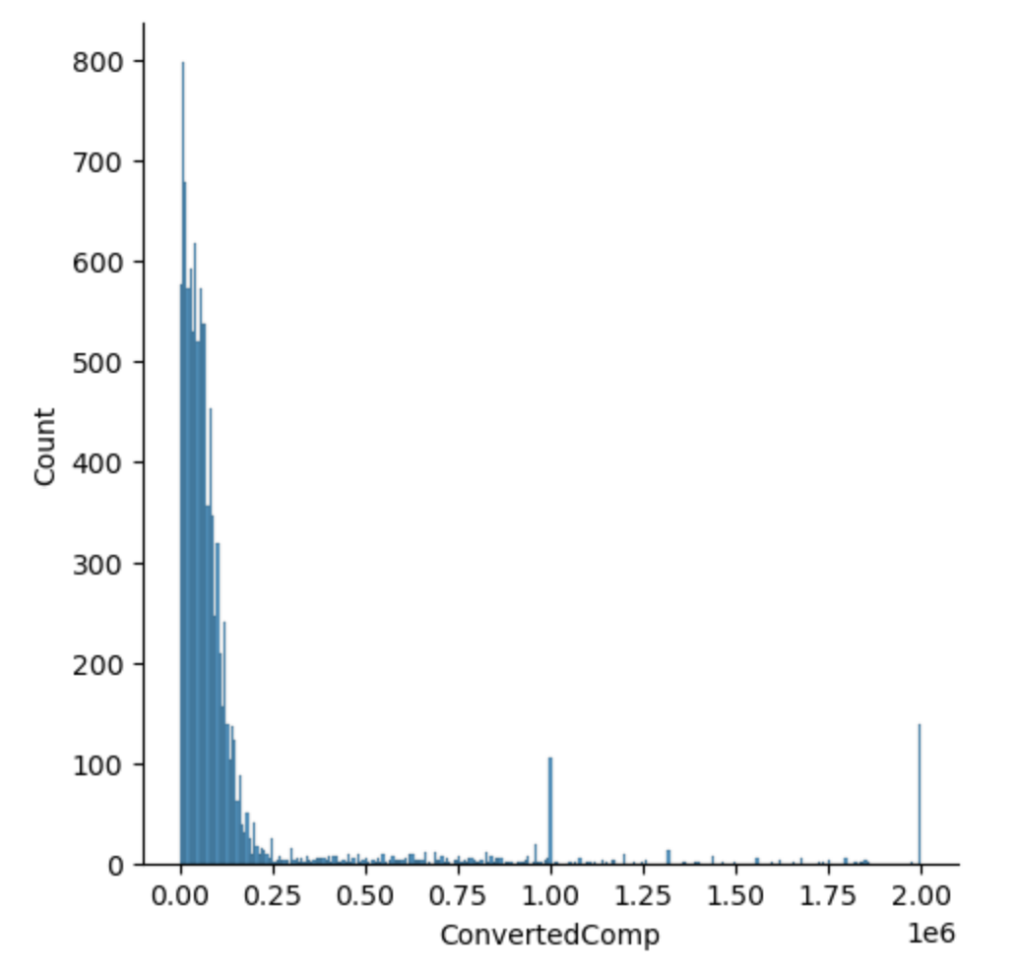
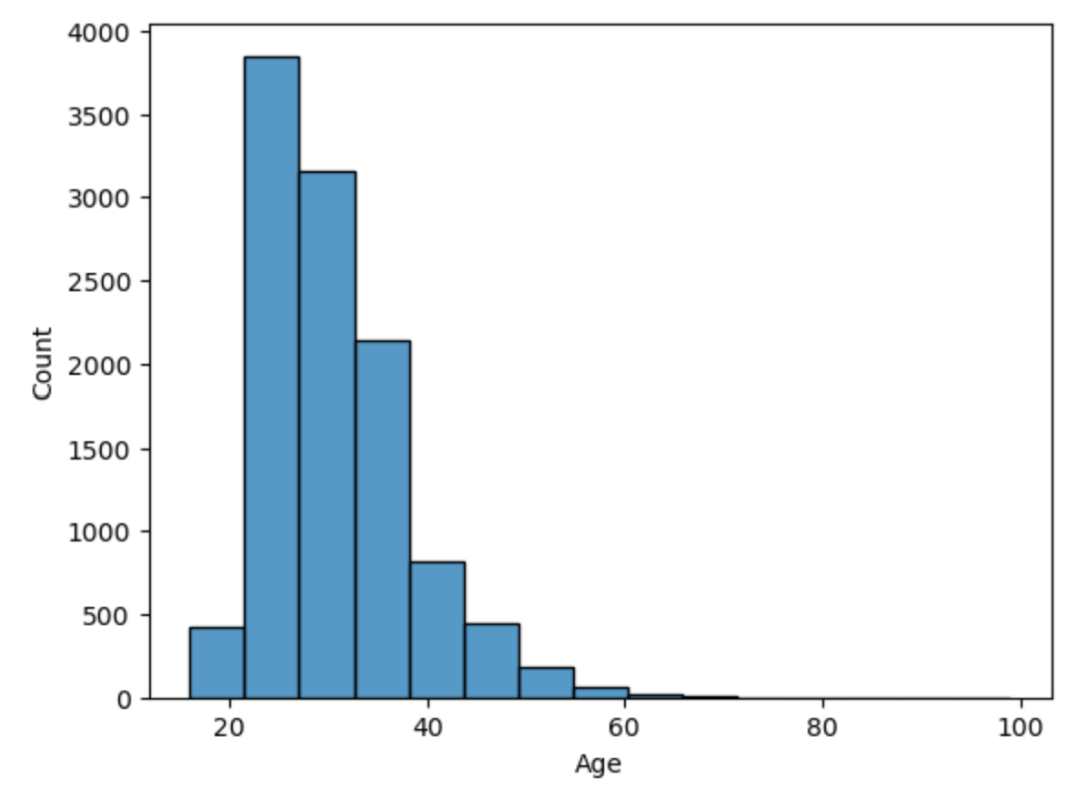
Exploratory Data Analysis
Screenshots shows the use of plots to portray data that can be easily interpreted and analyzed.
Distribution Plot
Histogram Plot
This Photo by Unknown author is licensed under CC BY-SA.

Slide 16
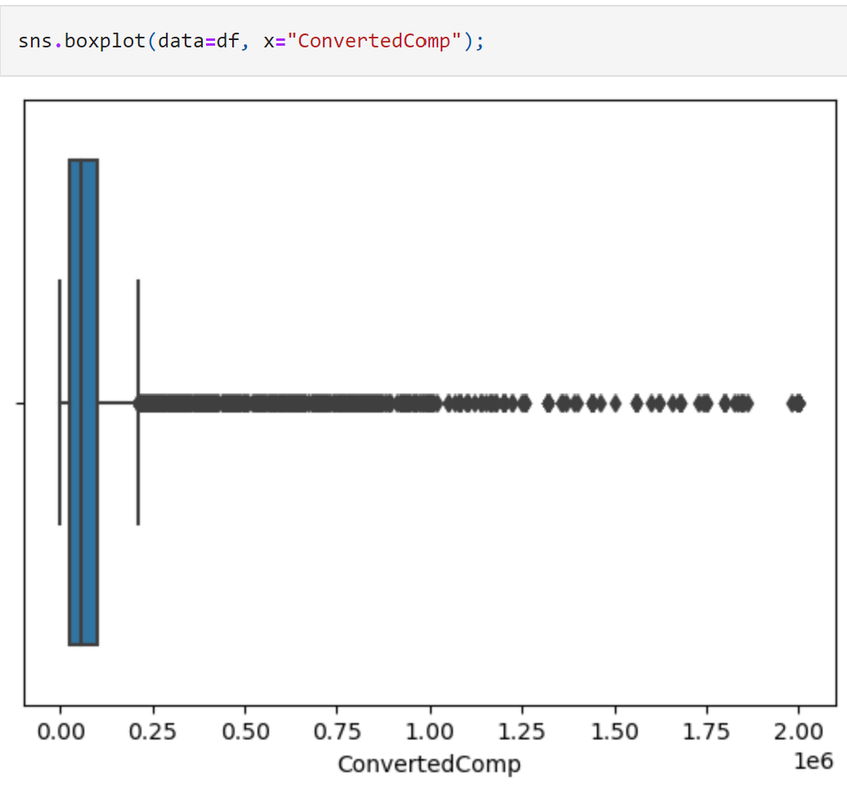
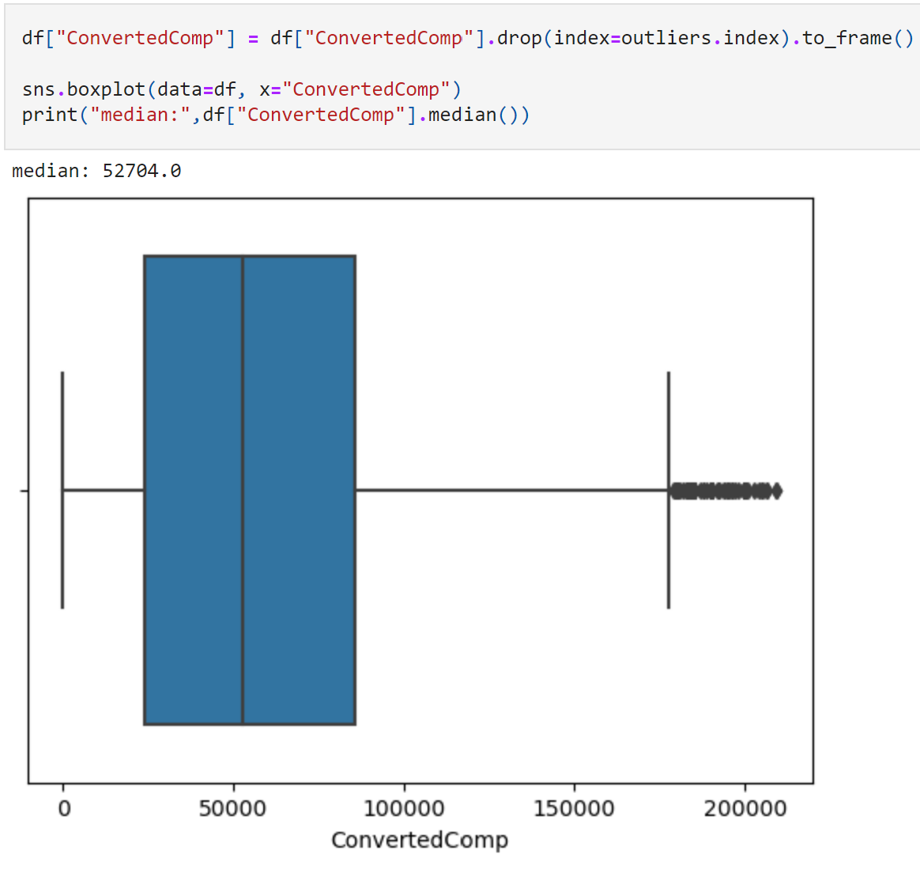
Exploratory Data Analysis
Screenshot shows the use of Boxplots and inter quantile ranges to show outliers in the data.
Box Plot with Outliers
Box Plot without Outliers
This Photo by Unknown author is licensed under CC BY-SA.

Slide 17
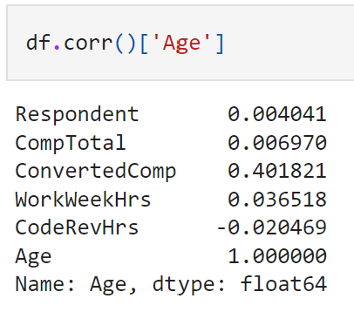
Exploratory Data Analysis
Screenshot shows the correlation of the variable 'Age' with other variables.
It also indicates the positive, negative and less to no correlation with the variable Age.
This Photo by Unknown author is licensed under CC BY-SA.

Slide 18
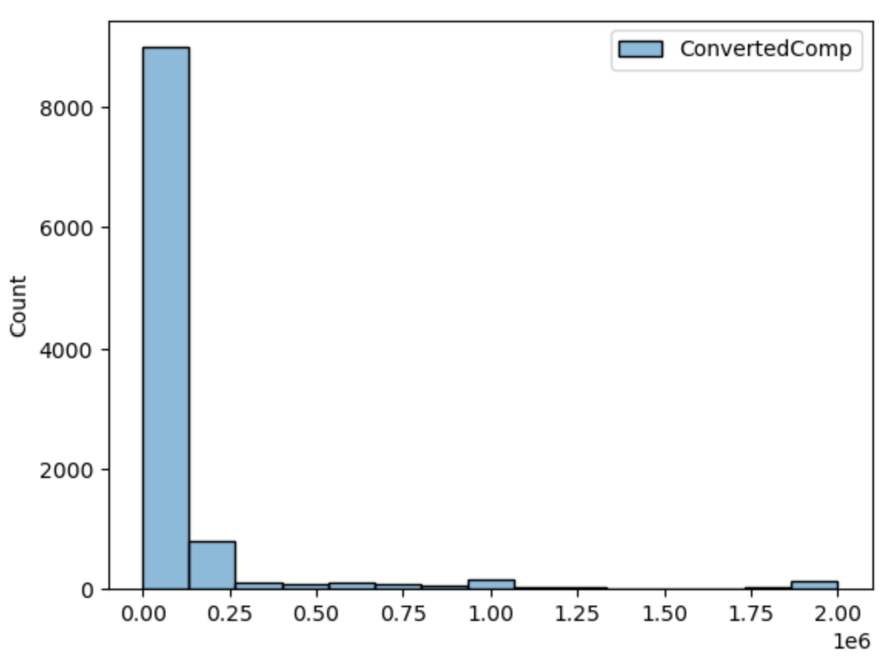
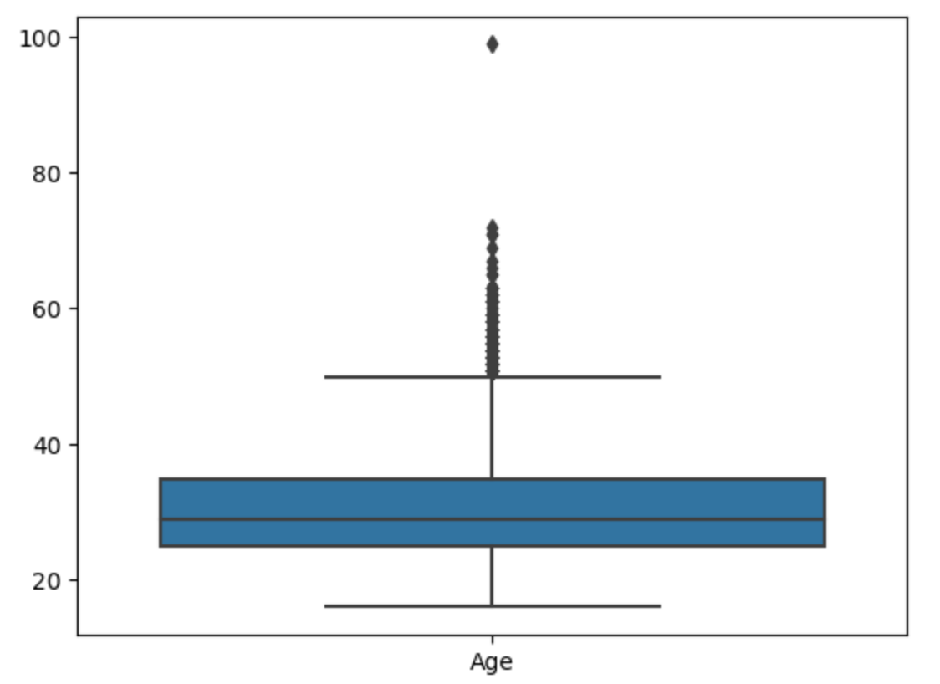
Data Visualization with Charts
Data Visualization as a data analyst deals with numerous charts and data sets.
Histogram Plots
Box Plots
This Photo by Unknown author is licensed under CC BY-SA.

Slide 19
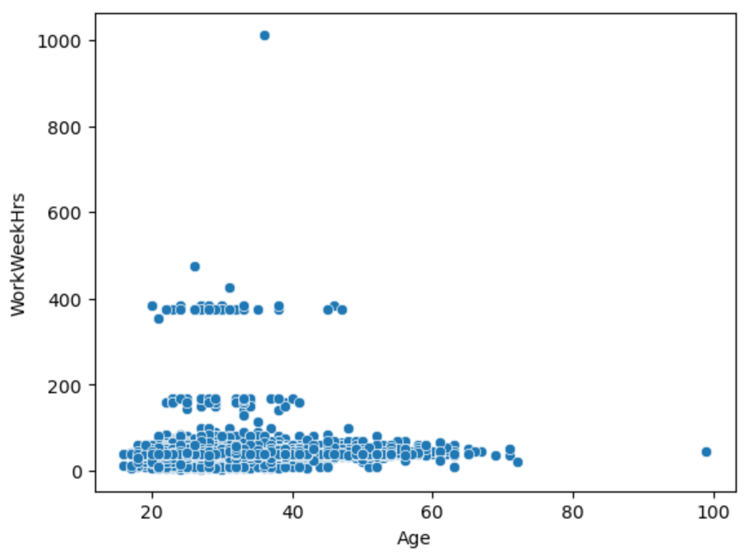
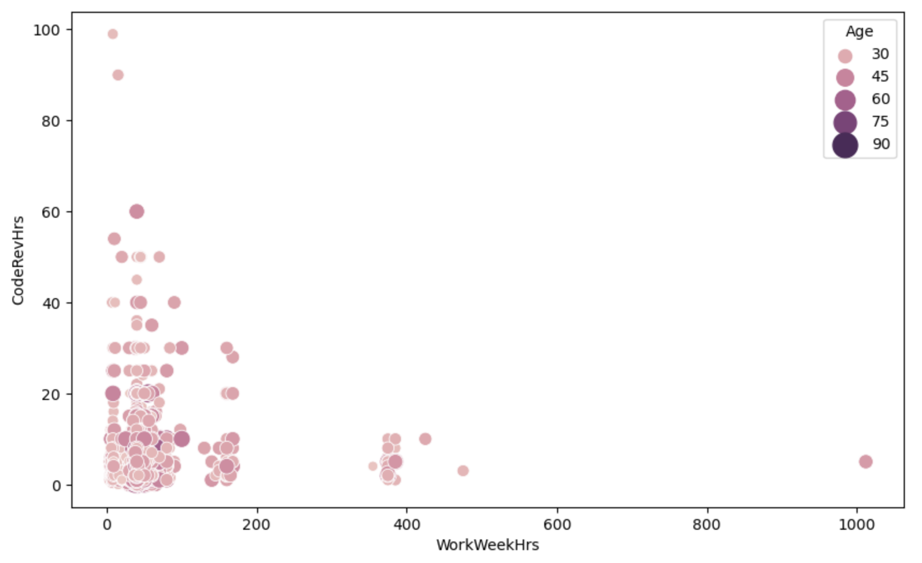
Data Visualization with Charts
Data Visualization as a data analyst deals with numerous charts and data sets.
Scatter Plots
Bubble Plots
This Photo by Unknown author is licensed under CC BY-SA.

Slide 20
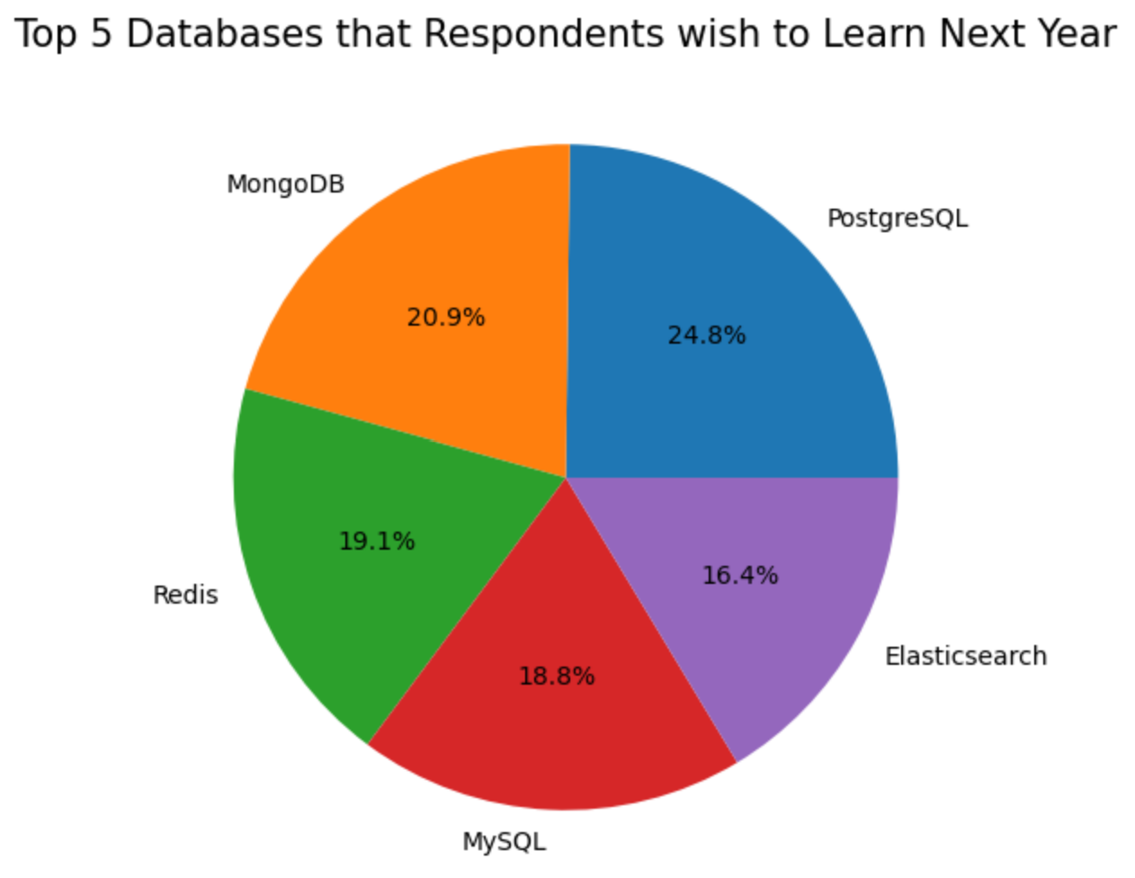
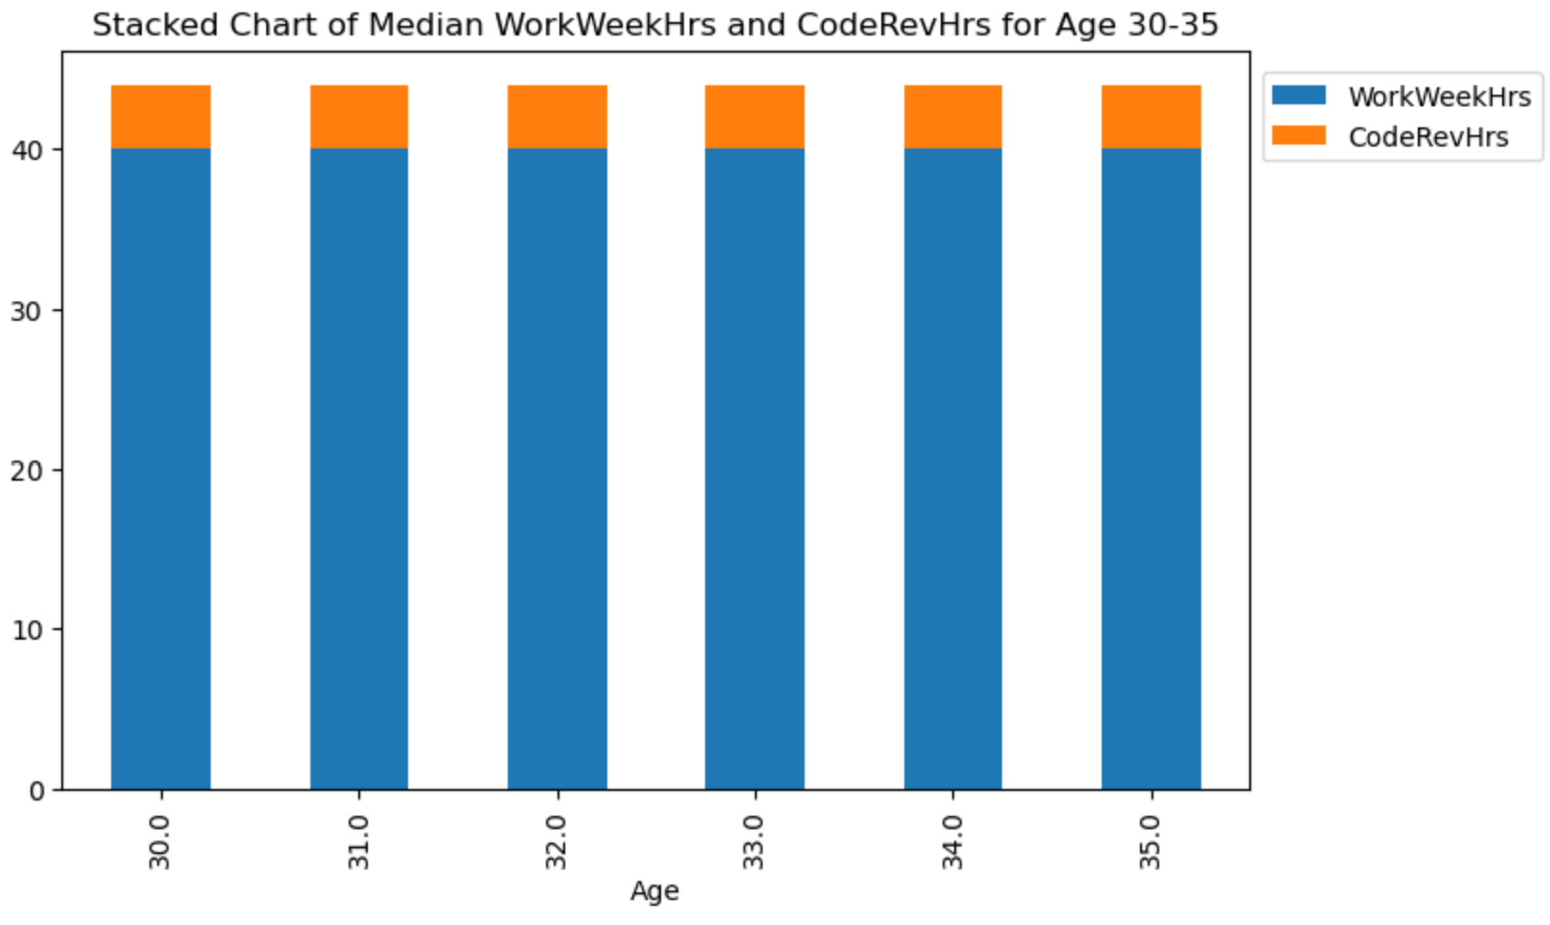
Data Visualization with Charts
Data Visualization as a data analyst deals with numerous charts and data sets.
Pie Chart
Stacked Charts
This Photo by Unknown author is licensed under CC BY-SA.

Slide 21
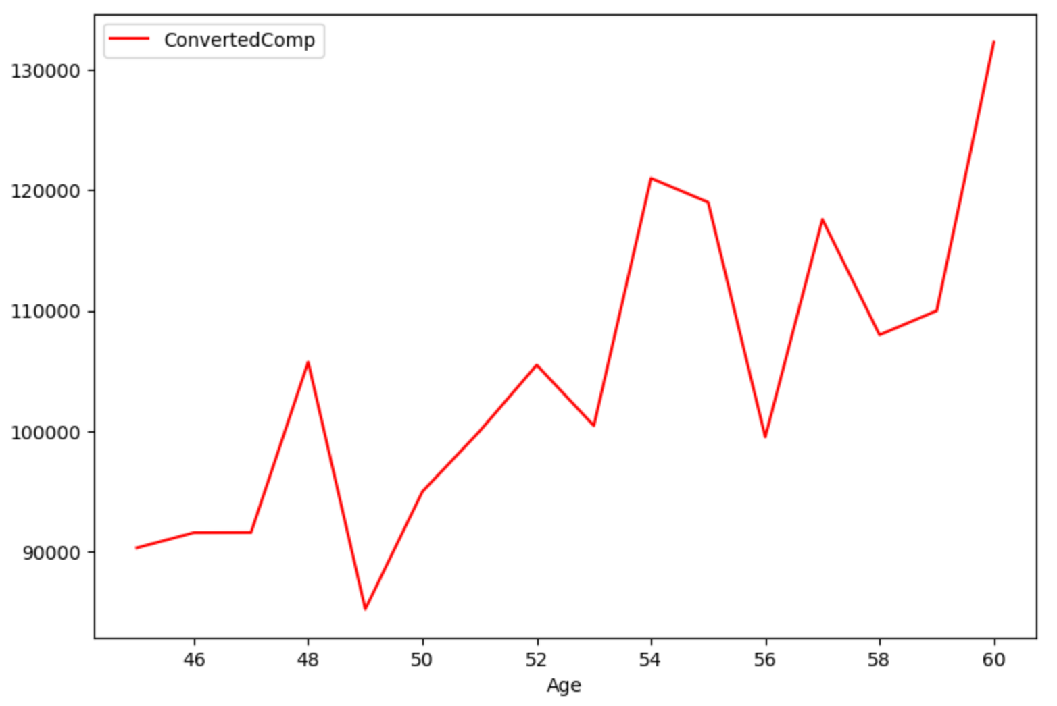
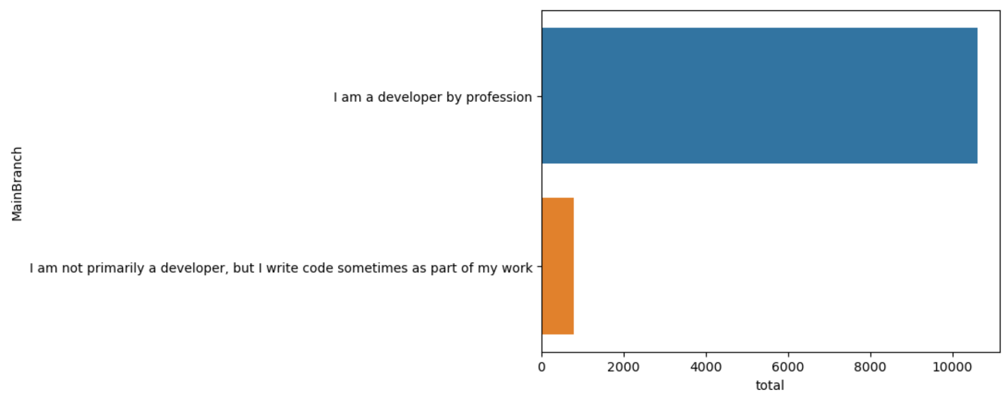
Data Visualization with Charts
Data Visualization as a data analyst deals with numerous charts and data sets.
Line Plot
Bar Plot
This Photo by Unknown author is licensed under CC BY-SA.

Slide 22
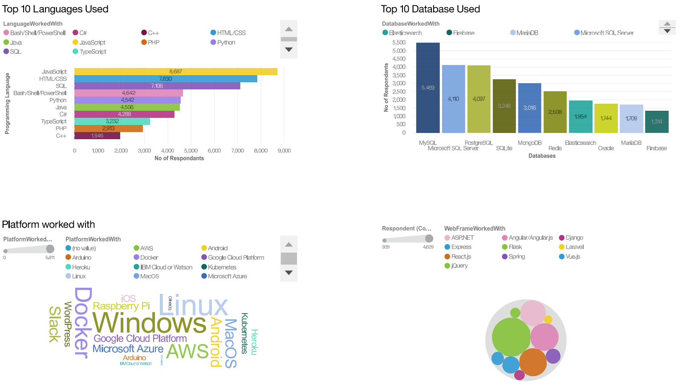
Dashboard Using IBM Cognos Analytics
This Photo by Unknown author is licensed under CC BY-SA.

Slide 23
Key Inferences - Programming Languages
Inference
JavaScript and HTML/CSS stay top 2 used programming languages and will continue to be top 2 next year.
The use of Python is expected to increase next year from current year.
Interest to use SQL/Powershell SQL in the next year has decreased.
Consequence
Employment with JavaScript and HTML/CSS will remain in demand next year.
Python developers' employment demand will surge next year.
SQL developers' employment will reduce next year
This Photo by Unknown author is licensed under CC BY-SA.

Slide 24
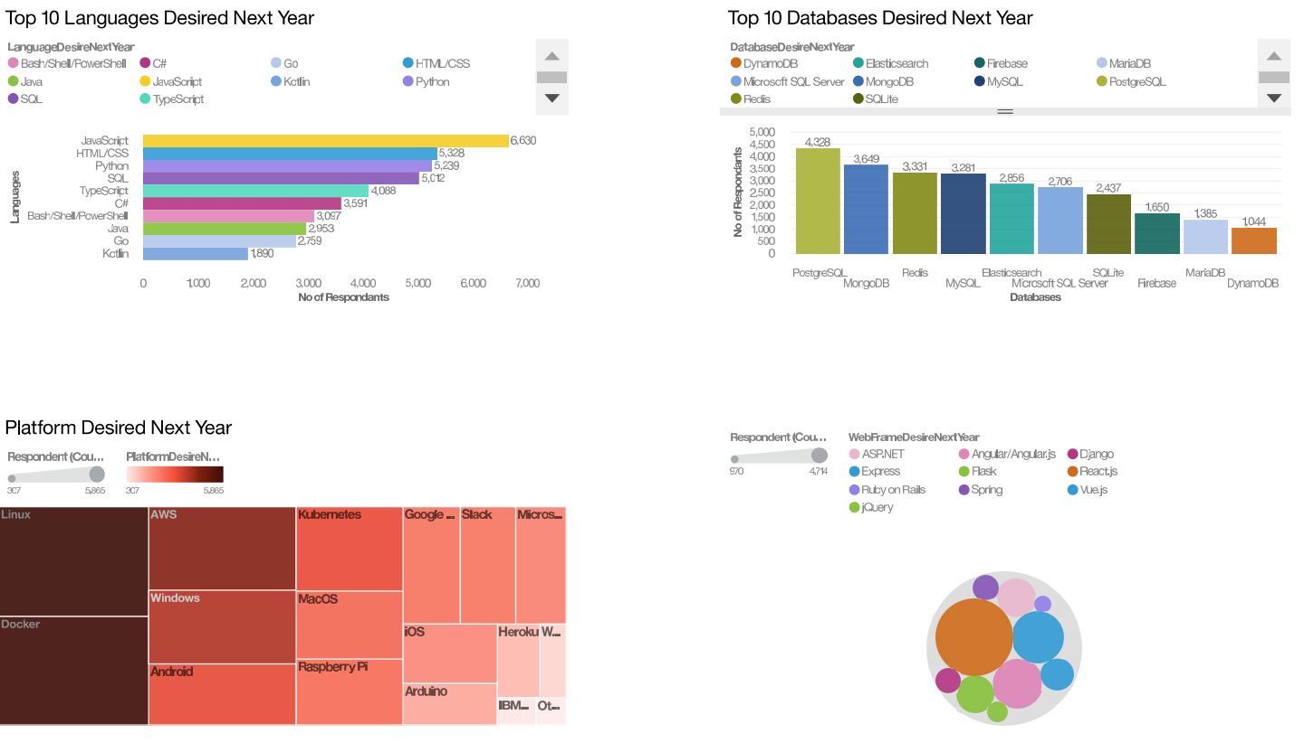
Dashboard Using IBM Cognos Analytics
This Photo by Unknown author is licensed under CC BY-SA.

Slide 25
Key Inferences - Databases
Inference
Desire to use MySQL, Microsoft SQL server and SQLlite has decreased in the next year.
The desire of PostgreSQL and MongoDB is expected to increase next year.
Interest to Redis and Elasticsearch in the next year has increased.
Consequence
Less employment in MySQL, Microsoft SQL server and SQLlite as compared to previous year.
Employment in PostgreSQL and MongoDB is likely to increase next year
Employment in Redis and Elasticsearch is set to increase.
This Photo by Unknown author is licensed under CC BY-SA.

Slide 26
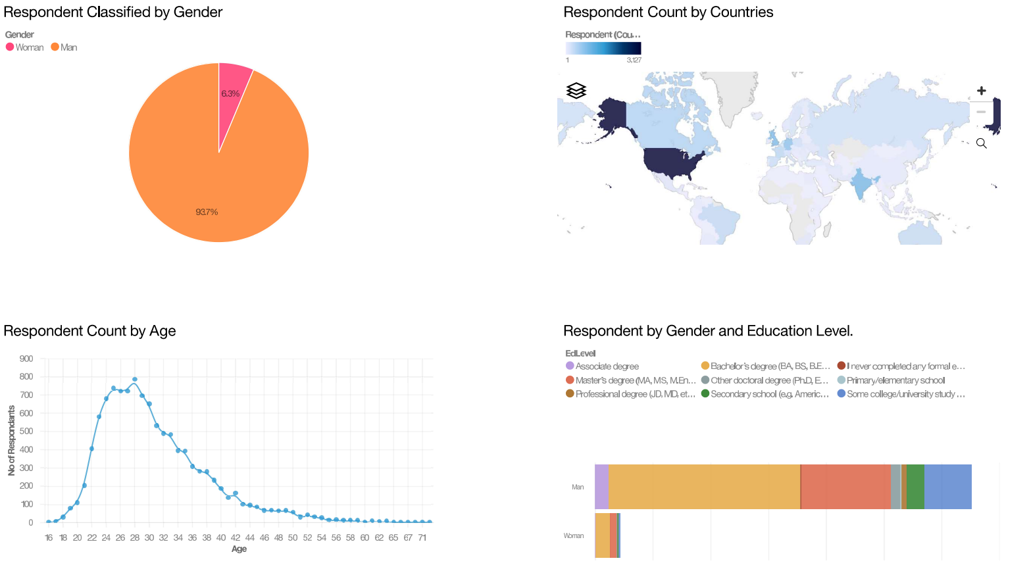
Dashboard Using IBM Cognos Analytics
This Photo by Unknown author is licensed under CC BY-SA.

Slide 27
Key Inferences - Demographics
Inference
93.6% respondents in the survey are men.
Most respondents are aged 20-30 with maximum education at a bachelor's level
Most respondents are from North America (Canada and United States).
Consequence
The tech industry seems to be male dominated.
The bulk of the industry's employees are bachelor's degree, less experienced.
Most tech respondents are situated in these countries.
This Photo by Unknown author is licensed under CC BY-SA.

Slide 28

Conclusions
Certain Programming Languages like Python and Databases like MongoDB have a rise in popularity amongst developers.
Companies can hire employees according to the desired next year market trends and company internal architecture.
Upskilling can be done to keep employees up to date with the latest trend.
More women can be employed into the workforce to promote an inclusive work environment.
This Photo by Unknown author is licensed under CC BY-SA.

Slide 29
Appendix
This Photo by Unknown author is licensed under CC BY-SA.

Slide 30
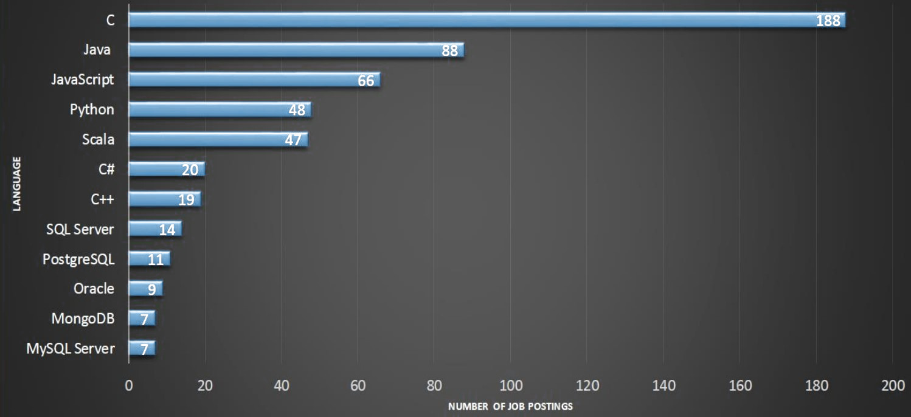
This Photo by Unknown author is licensed under CC BY-SA.

Slide 31
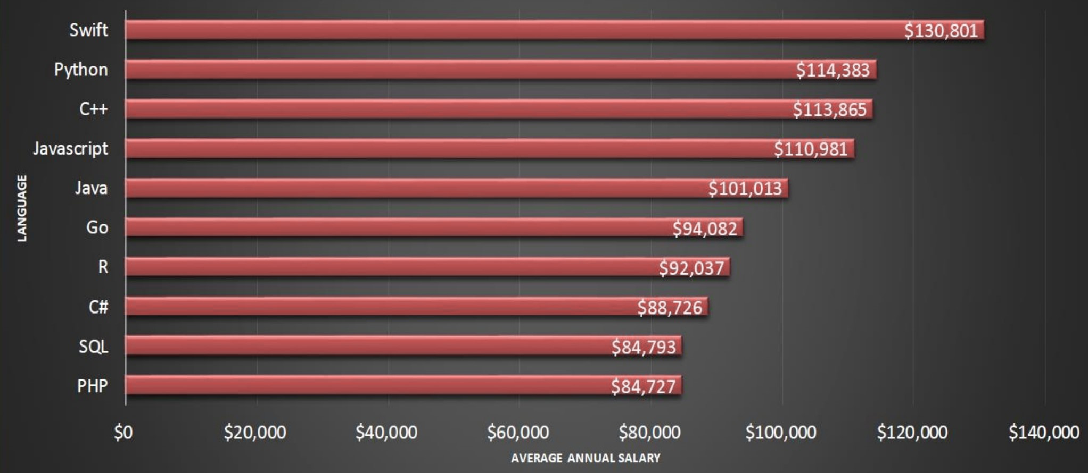
This Photo by Unknown author is licensed under CC BY-SA.

Slide 32

Thank you

